Slide 1
Domestic Molding Prediction
Presentation By : Shashanka
https://github.com/shashank338/Domestic-Molding-Prediction
https://docs.google.com/spreadsheets/d/16-eYf8GrOYospz2oUgCGbOBeyjmWO1GbkPEQKS0JZFk/edit?usp=sharing

Slide 2
Agenda.
Data cleaning steps.
Model Building.
Hyper Parameter Tuning.
Saving the model and making predictions.
Conclusion.
Overview.
Problem Statement
Problem Understanding.
What is Domestic MoldingPrediction?
Importance of Domestic MoldingPrediction.
Exploratory data analysis.
Visualizations.
Analysis

Slide 3
Overview.
In this particular presentation we will be looking on:
How to analyze the dataset of is Domestic MoldingPrediction.
What are the EDA steps in cleaning the dataset.
Overall analysis on the problem.
Model building from cleaned dataset.
Predicting Domestic Market for saved best model.

Slide 4
Problem Statement.
Domestic molding is a crucial aspect of the manufacturing industry as it is used to produce consumer goods. However, predicting the outcome of domestic molding processes can be challenging, leading to potential waste and inefficiency. The aim of this project is to develop a machine learning model that can accurately predict the outcome of domestic molding processes using preprocessed data. The code included in the repository provides the necessary functions to load, clean, and preprocess data in preparation for building the model.
The code includes, EDA, Model building from cleaned dataset and the total Model building
Finally, the jupyter notebook exploratory data analysis provides a detailed step-by-step guide on how to use the various components to train the model. The goal of this project is to develop a domestic molding prediction model that is accurate and efficient, making the manufacturing industry more productive and sustainable.

Slide 5
Problem Understanding.
The Domestic Molding happens at various countries in Global
So we got some data bases on market value of import and export and production
From certain years dataset we checked where domestic Molding getting impacts or not
what is the status of Domestic molding present and what will be status of market value will predict by these datas

Slide 6
What is Domestic molding Prediction?
A mold or mold is a hollowed-out block that is filled with a liquid or pliable material such as plastic, glass, metal, or ceramic raw material.The liquid hardens or sets inside the mold, adopting its shape. A mold is a counterpart to a cast. The very common bi-valve molding process uses two molds, one for each half of the object. That’s why we will try to use machine learning to solve this problem.
The above process is molding this molding products should sell highly and maintaining consistence so previous data will help us to improve the business by taking previous data predict Future.This can help the small scale industries business

Slide 7
Importance of Domestic molding Prediction.
Reduces Assembly and Labor Costs: As insert molding combines a number of components with thermoplastic, it helps minimize the assembly and labor costs. For example, you can over mold a single stamping, and then perforate it to create numerous circuit paths.
Filler materials are particles added to resin or binders plastics, composites, concrete that can improve specific properties, make the product cheaper, or a mixture of both. The two largest segments for filler material use is elastomers and plastics. Worldwide, more than 53 million tons of fillers with a total sum of approximately US$18 billion are used every year in application areas such as paper, plastics, rubber, paints, coatings, adhesives, and sealants. As such, fillers, produced by more than 700 companies, rank among the world's major raw materials and are contained in a variety of goods for daily consumer needs.

Slide 8
Exploratory Data Analysis.

Slide 9
Firstly, I got Datasets From Taiyo.Ai
Then I did all the statistical analysis like checking shape, nunique, value counts, info etc.
I have understand the dataset and problem
While checking for null values I found no null values in the dataset.

Slide 10
I have extracted useful information from the raw dataset. Thinking that this data will help us more than raw data. Then, I check the statistical description of our dataset.While checking for null values I found null values in the dataset.
I have extracted useful information from the raw dataset. Thinking that this data will help us more than raw data.
Then, I check the statistical description of our dataset.
Then filled the Null values with Mean and Mode
Then, I proceeded with Data visualization for better understanding of the data.

Slide 11
Visualizations.
Univariate & Multivariateof different features in the dataset.
I have used Univariate and Multivariate for dataset better undersetting

Slide 12
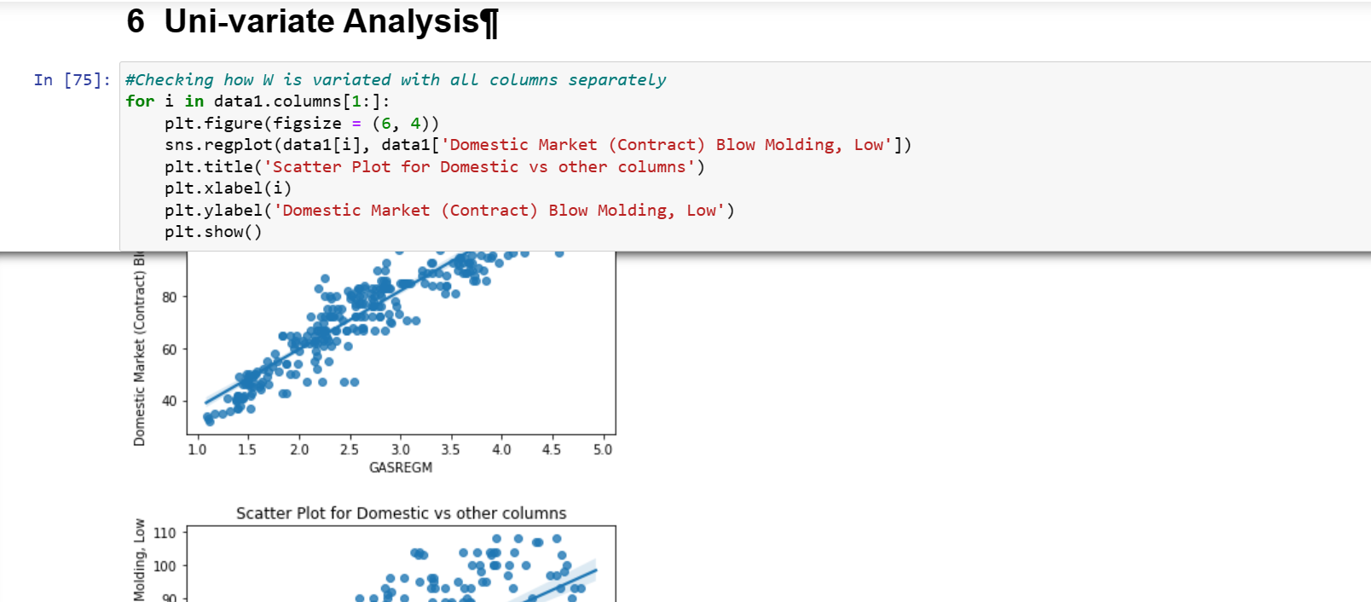
OBSERVATION: Here observed the data sets .

Slide 13
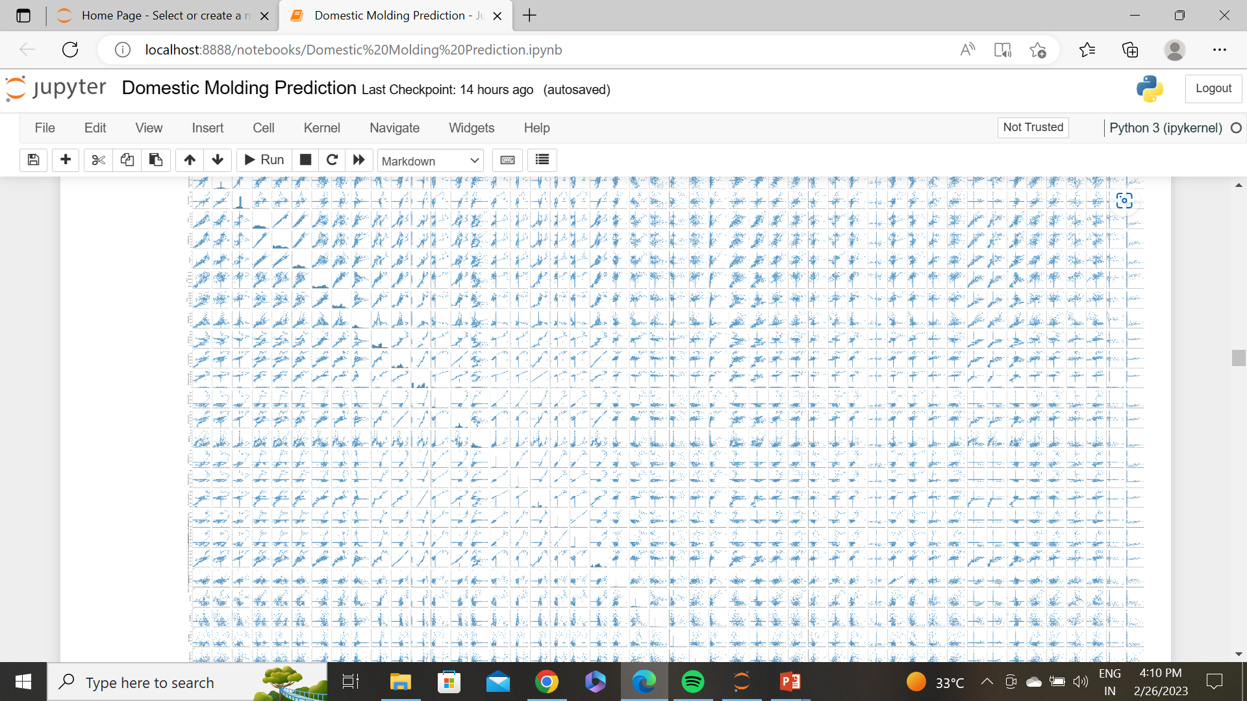
OBSERVATIONS:
all data observed by different plots and paired

Slide 14
Analysis.
UNIVARIATE ANALYSIS :
I have used dist plot to check the skewness in numerical columns.
I have used each plot for Data sets what impacts happens
MULTIVARIATE ANALYSIS :
I have used bar plot for visualizing the relation between categorical columns and our target column,
And also for continuous numerical variables found so its help us to found the model e

Slide 15
Data Cleaning Steps.
Some columns had incorrect data types which had to be changed to the right data type for visualization and model building.
Also, feature extraction was performed to extract useful features.
In the dataset, I found no null values, outliers and also no skewness.
Encoding of the categorical columns was done using Label Encoder.
Use of Pearson’s correlation coefficient was done to check the correlation between dependent and independent features.
Also standardization was conducted using Standard Scaler.
Lastly, followed by model building with all regression algorithms.

Slide 16
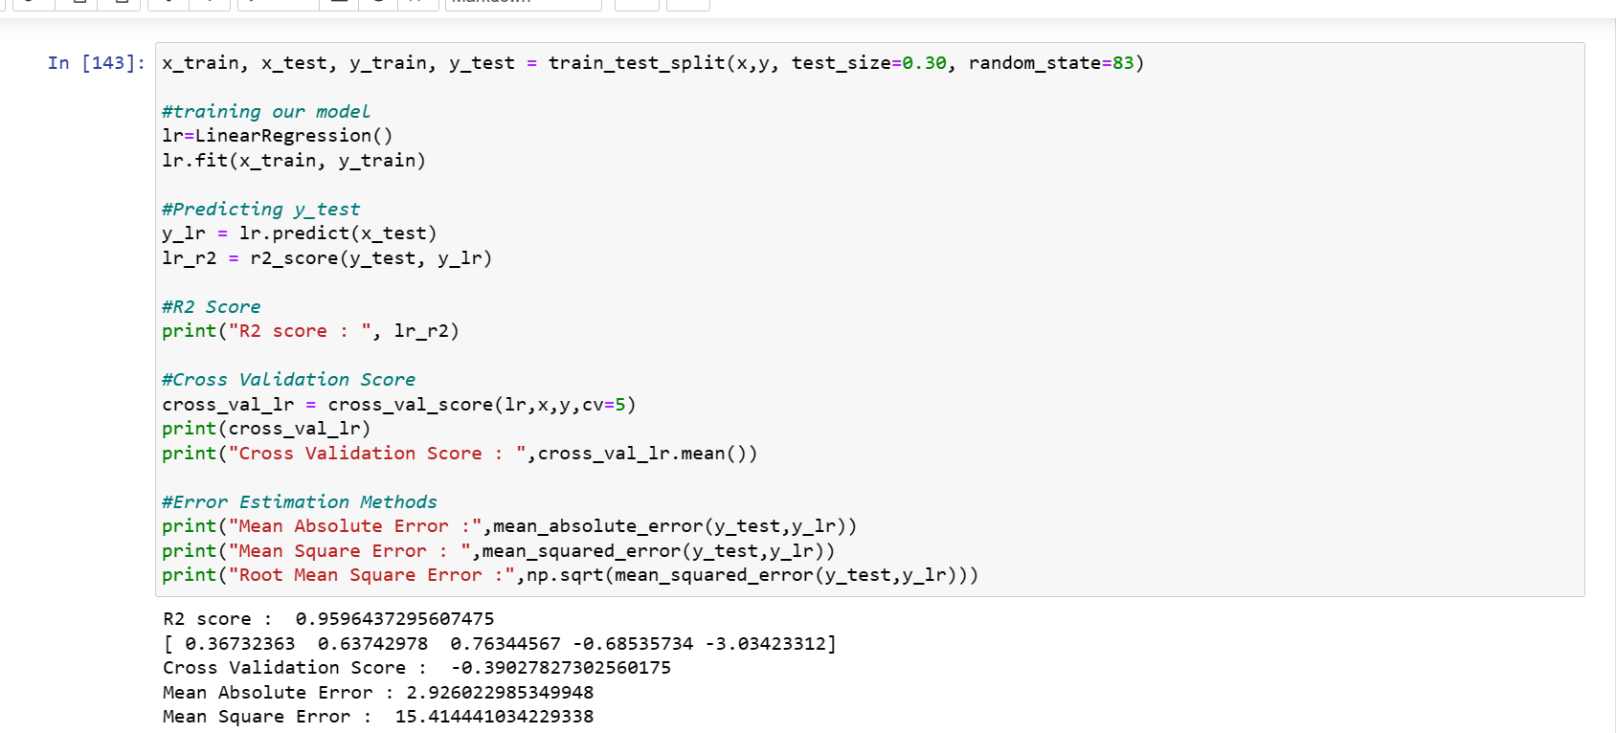
Logistic Regression
The Logistic Regression
Regressor model gave us an R2 Score of 95.96 %.

Slide 17
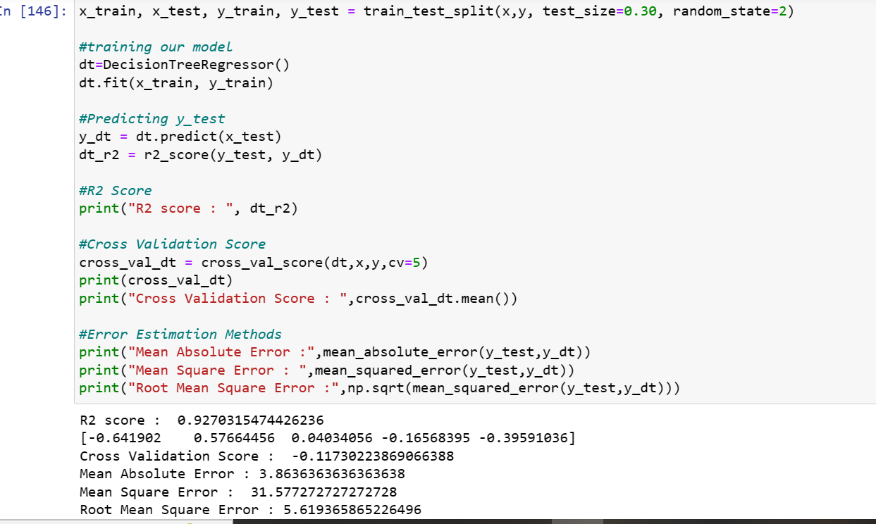
DecisionTrees Regressor.
The Decision Trees Regressor model gave us an R2 Score of 92.70 %.

Slide 18
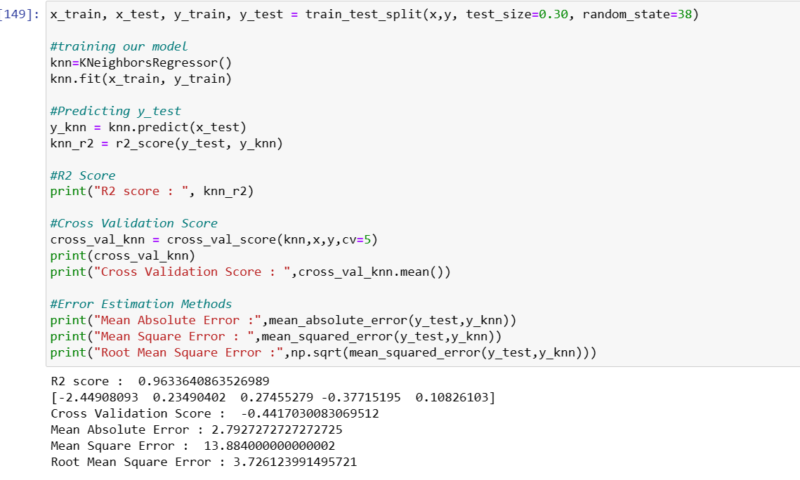
KNN
The KNN Regressor model gave us an R2 Score of 96.33 %.

Slide 19
Analysis of Regression Models.
From the above regression models, the highest R2 score belongs to the Random Forest Regressor Model, followed closely by Randm Forest Regressor Model & KNN Model.
Next, the Ada Boosting Regressor Model.
Lastly, the XGBoost Model.
Finally, the lowest score belongs to Gradient Boosting Regressor

Slide 20
Hyper Parameter Tuning.
Since the R2 Score is the Highest and the RMSE score is the lowest in Random Forest Regressor Model, we shall consider it for hyper parameter tuning.
We shall use GridSearchCV for Hyper Parameter Tuning.

Slide 21
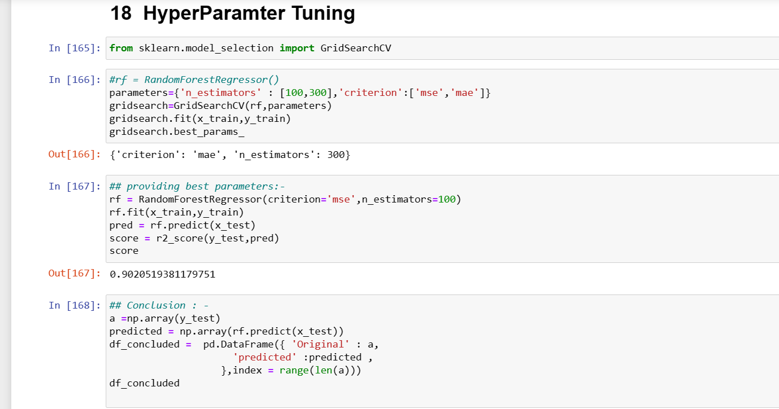
Hyper Parameter Tuning.
After Hyper Parameter Tuning, we have got a R2 score of 90.20 %.

Slide 22
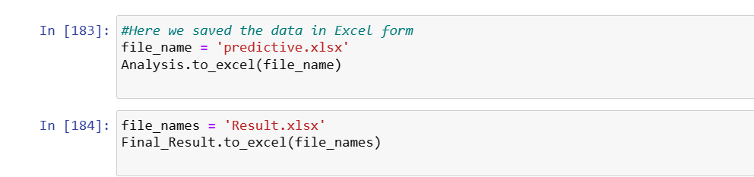
Saving the Best Model & Making Predictions.
Now we shall save the best model.

Slide 23
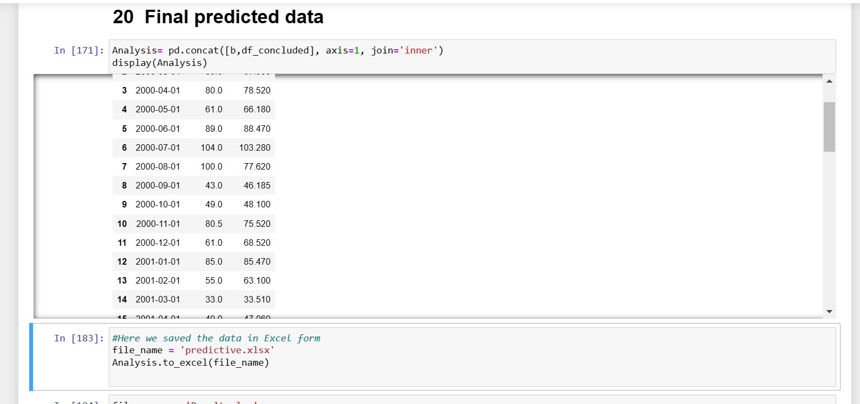
Saving the Best Model & Making Predictions.
Putting the predicted & actual values in a dataframe.

Slide 24
Conclusion.
Here some NULL value handled and dataset cleaning done then i taken 30% data and trained the model then i got the 98% out put from Random Forest model
Then i checked predicted data set found (MM//YY) 1/2000 and 5/2000,3/2003 these year the market was in low condition the confident value got little bit low
As per my predict All data set checked up to 2004 i predict that the Domestic Molding business marketing across the Global is good in at that time and Future also, by concluding that model by 98% accuracy score
.

